Slide 1
ML OPs
Day 1
David Pratap

Slide 2
Contents ML OPs
Day1 - Deployment of Machine Learning Model is Streamlit
Day2 - Deployment of Deep Learning Model in Streamlit
Day3 - Deployment of Deep Learning Model in TensorFlow Serving
Day4- Deployment of Deep Learning Model in GCPCloud

Slide 3
Contents Day1
Prerequisites for ML Project
Intro to Deployment
Intro to Git and Github
Intro to Streamlit and Streamlit Sharing
Deployment demo1 of plotting apps in local streamlit
Intro to ML OPs
Deployment Demo of Full Fledged ML model as Web App in Streamlite Sharing

Slide 4
Prerequisites for ML project
Anaconda Virtual Environment
Git and Github account
Streamlit sharing
VS Code(optional)

Slide 5
Virtual Environments
Using virtual environments allows you to avoid installing Python packages globally which could break system tools or other projects
For our deployment projects we will create a new virtual environment in Anaconda as follows:
Open an Anaconda Prompt and type the following code to create a virtual environment of name venv in python version 3.8.13
.
> conda create --name venv python=3.8.13 anaconda
Once done check the venv using
> conda info --envs
Now activate the virtual environment as follows
> activate venv

Slide 6
Intro to Git and Github * ( * https://www.w3schools.com/git/default.asp?remote=github)
What is Git?
Git is a popular version control system. It was created by Linus Torvalds in 2005, and has been maintained by Junio Hamano since then.
It is used for:
Tracking code changes
Tracking who made changes
Coding collaboration
What is GitHub?
Git is not the same as GitHub.
GitHub makes tools that uses Git.
GitHub is the largest host of source code in the world, and has been owned by Microsoft since 2018.

Slide 7
Getting Started with Git and Github
Step1: Sign in for a Github account at https://github.com/ using your email id.
Step2: Get Git on your local computer . For that go to https://git-scm.com/downloads and follow instructions. See the attached documnet to add the SSH keys to Github
Step 3: Once you have got both Github account and Git you are ready to go. For Windows, you can use Git bash, which comes included in Git for Windows. For Mac and Linux you can use the built-in terminal.
Step4: The first thing we need to do, is to check if Git is properly installed. Open Git bash and type the following code
> git --version

Slide 8
Getting Started with Git and Github
Step5:Configure Git
Now let Git know who you are. This is important for version control systems, as each Git commit uses this information:
>git config --global user.name “asdf user"
> git config --global user.email "asdf123@gmail.com"
Note: Use global to set the username and e-mail for every repository on your computer. Also use the same email that you used to register for github.com

Slide 9
Getting Started with Git and Github
Step6: Creating Git Folder
> cd Desktop
> mkdir myprojects
> cd myprojects
mkdir makes a new directory.
cd changes the current working directory.
Now that we are in the correct directory. We can start by initializing Git!
Note: If you already have a folder/directory you would like to use for Git:
Navigate to it in command line, or open it in your file explorer, right-click and select "Git Bash here"

Slide 10
Getting Started with Git and Github
Step7: Initialize Git
Once you have navigated to the correct folder, you can initialize Git on that folder:
> git init
Congrats You just created your first Git Repository!

Slide 11
What is Streamlit ?
Streamlit is a web application framework that helps you to build and develop Python based web applications and can be used to share analytics results , build complex interactive experiences and illustrate new Machine Learning Models
Developing and Deploying Streamlit apps is extremely fast and flexible often turning application development time from days to hours

Slide 12
Why Streamlit
Streamlit helps data scientists to not only build their python machine learning models but deploy them with equal ease to showcase to colleagues and clients
Other options include using frameworks like Flask or Django and then deploy the entire app in AWS or other cloud providers.
On the other hand Streamlit has built-in and convenient methods for taking user input, graphing and using the most popular and powerful Python libraries and quickly deploying web applications.

Slide 13
Installing Streamlit
To install Streamlit run the following code in a anaconda terminal
> pip install streamlit
We can kick off streamlit from command line using the code
> streamlit hello

Slide 14
Streamlit Plotting Demo
We will do the following
Make a Python file where we will house all our Streamlit Code
mkdir plotting_app
cd myfirstapp
type nul > demo.py
Create out plotting demo code
Now open the demo.py using a VS code and type the code for the app

Slide 15
Code for clt.py
import numpy as np
import streamlit as st
import matplotlib.pyplot as plt
st.title("CLT Demo in Streamlit")
st.write("This app simulates a 1000 coin flips, samples with replacement from that population,"
"and then plots the histogram of the means of the samples")
heads=st.number_input('Chance of a head', 0.0, 1.0, 0.5)
binom_dist=np.random.binomial(1,heads, 1000)
sample_means=[]
for i in range(0, 1000) :
sample_means.append(np.random.choice(binom_dist, 100, replace=True).mean())
fig, ax=plt.subplots()
ax=plt.hist(sample_means)
st.pyplot(fig)

Slide 16
Streamlit Plotting Demo
Run our file locally
Open a new anaconda prompt
cd myfirstapp
streamlit run demo.py

Slide 17
Code for pushing clt.py to github
git init
git add .
git status
git commit -m "first commit"
git remote add origin https://github.com/davidgldemo/myfirstapp.git
git push -u origin master

Slide 18
Streamlit Sharing
Streamlit Sharing helps to Deploy, manage, and share your apps with the World directly from Streamlit — all for free.
Streamlit turns data scripts into shareable web apps in minutes.
All in pure Python. No front‑end experience required.
Step1 : Go to https://streamlit.io/
Step2 : Sign up for community Cloud > Get started > Continue with Github

Slide 19
Code for ML Demo in Streamlit
Create a web app using streamlit for Medical Diagnostics
Deploy the App using Streamlit Sharing as a web url
Be sure to create requirements.txt. For that open anaconda prompt and and type the following code
> pip install pipreqs
Next navigate to the directory and type
> pipreqs .
Happy Building Your First App

Slide 20
What is ML OPs?
ML OPs is a set of tools and best practices in industry for design , development and deployment of Machine Learning Models to optimize the ML life cycle.
A typical ML Project life cycle has the followings steps
Design
Development
Deployment

Slide 21
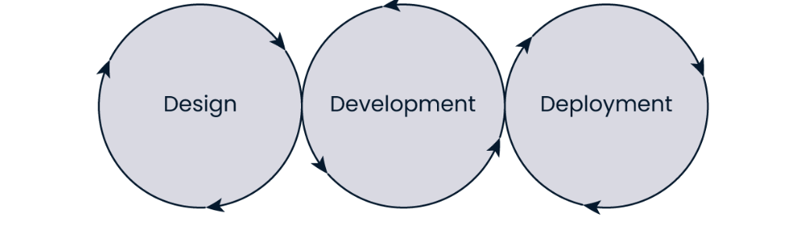
ML OPS Phases

Slide 22
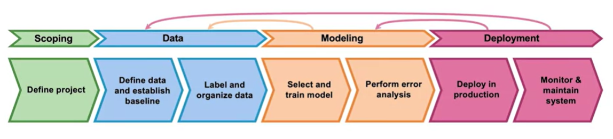
ML OPS LIfe Cycle *
Taken from deeplearning.ai

Slide 23
ML Life cycle Steps
DESIGN
1.Data Acquisition
2.Exploratory Data Analysis – univariate & bivariates & correlations
3. Data Preprocessing
DEVELOPMENT
4. Model Building with training data – Fit the model
5. Model evaluation with test data – Check the metrics
6. Model optimization-Hyperparameter tuning
7. Model interpretation
DEPLOYMENT
8. Model Deployment
9. Monitoring

Slide 24
Pop Quiz : Classify as Design, Development, Deployment
Do an experiment comparing two algorithms
Make an overview of potential data sources you need
Deploy the machine learning model in the business process
Talk to your business manager/client as to how accurate the ML model should be
Combine two features to produce a new feature for your ML model
Do a weekly check of you ML model Predictions

Slide 25
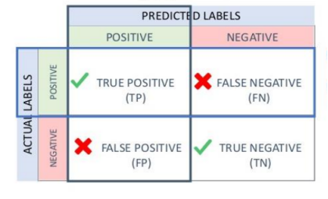
Evaluation Metrics for Classification- Confusion Matrix
Precision and Recall are metrics that are used for evaluating the performance of a classification algorithm. These can be understood more clearly using a confusion matrix as shown beside.
Precision is the proportion of true positives among those predicted positives. So Precision is a % expressing the accuracy with which positive classes are predicted. As a formula Precision = TP/(TP+FP)
Recall on the other hand is the proportion of true positives among those that are actually positive. So recall is a % expressing the capacity of the model to recall positive values. As a formula Recall =TP/(TP+FN)
These measures are very useful in a marketing scenario

Slide 26
Pop Quiz
Which of the following situations looks like an example of overfitting?
Training accuracy 50%, testing accuracy 50%.
Training accuracy 95%, testing accuracy 95%.
Training accuracy 95%, testing accuracy 50%.
Training accuracy 50%, testing accuracy 95%.

Slide 27
Algorithms for Classification
K Nearest Neighbors
Logistic Regression
—---------------------------------
Decision Trees
Voting Classifier
Bagging Classifier
Random Forest
Naive Bayes
—----------------------------------
Gradient Boosting
Adaboost Classifier
XgBoost Classifier
SVM

Slide 28
KNN
The k-nearest neighbors (KNN) algorithm is a supervised machine learning algorithm.
KNN assumes that similar things exist in close proximity. This implies that similar data points are close to each other. KNN calculates the distance between points on a graph to decide similarity
The distance can be of any type, e.g., Euclidean, Manhattan, etc.

Slide 29
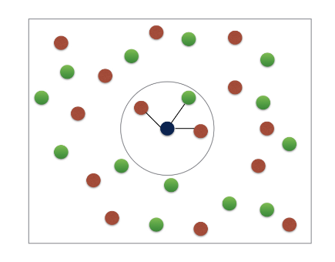
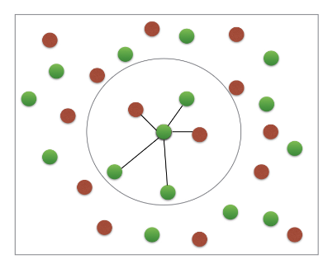
K- Nearest Neighbors
Basic Idea : predict the label of a data point by
Looking at “k” closest labelled data points
Taking a majority vote

Slide 30
KNN Advantages and Disadvantages
Advantages
Very easy to implement.
This algorithm can be used for both classification and
Regression.
Since data is not previously assumed, it is very useful in cases of nonlinear data.
The algorithm ensures relatively high accuracy.
Disadvantages
It is a bit more expensive as it stores the entire training data.
High memory storage requirements for this algorithm.
Higher sets of values may lead to inaccurate predictions.
Highly sensitive to the scale of the data.

Slide 31
KNN Uses
The following are some of the areas in which KNN can be applied successfully:
KNN is often used in banking systems to identify if an individual or organization is fit for a grant or a loan based on key characteristics.
KNN can be used in Speech Recognition, Handwriting Detection, Image Recognition, and Video Recognition.
A potential voter can be classified into categories based on characteristics (like “voter” or “non-voter”) for elections

Slide 32
Random Forest
Random forests are a form of ensemble learning where we use the concept of bagged trees
Random forests provide an improvement over bagged trees by way of a random small tweak that decorrelates the trees.
As in bagging, we build a number of decision trees on bootstrapped training samples
But when building these decision trees, each time a split in a tree is considered, a random sample of m predictors is chosen as split candidates from the full set of p predictors. The split is allowed to use only one of those m predictors. A fresh sample of m predictors is taken at each split, and typically we choose m ≈ √p

Slide 33
PROS of Random Forest
It reduces variance as taking many trees from n bootstrapped samples and averaging their prediction leads to lower variance
It also reduces bias in the dataset by decorrelating the trees which is a problem with imbalanced datasets
Random forests overcome this problem by forcing each split to consider only a subset of the predictors. Therefore, on average (p − m)/p of the splits will not even consider the strong predictor, and so other predictors will have more of a chance. We can think of this process as decorrelating the trees, thereby making the average of the resulting trees less variable and hence more reliable.

Slide 34
Hyperparameters for Random Forest
Criterion- can choose between ‘entropy and ‘gini’
Maximum Depth- the largest length between the root to leaf.
Minimum number of samples per leaf- we can set a minimum for the number of samples we allow on each leaf.
Minimum sample split - the minimum number of samples required to split an internal node
Maximum features - the number of features that one looks for in each split. We can shoose between ‘sqrt’ and ‘log2’

Slide 35
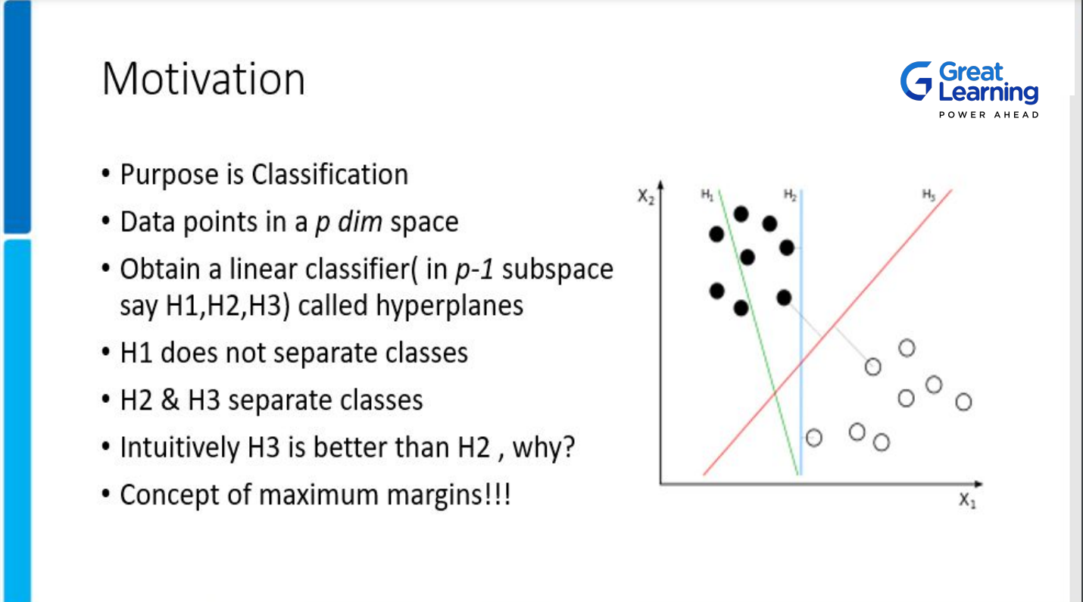
SVM
SVM

Slide 36
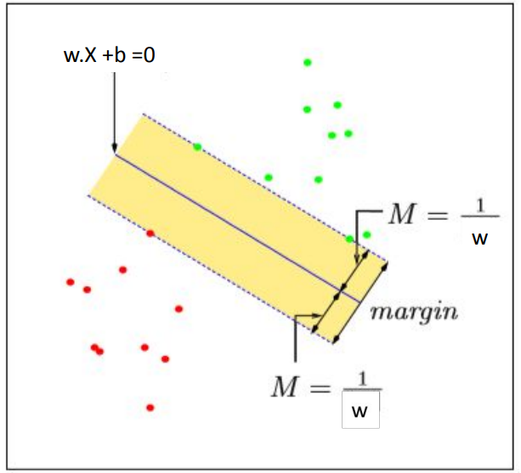
SVM

Slide 37
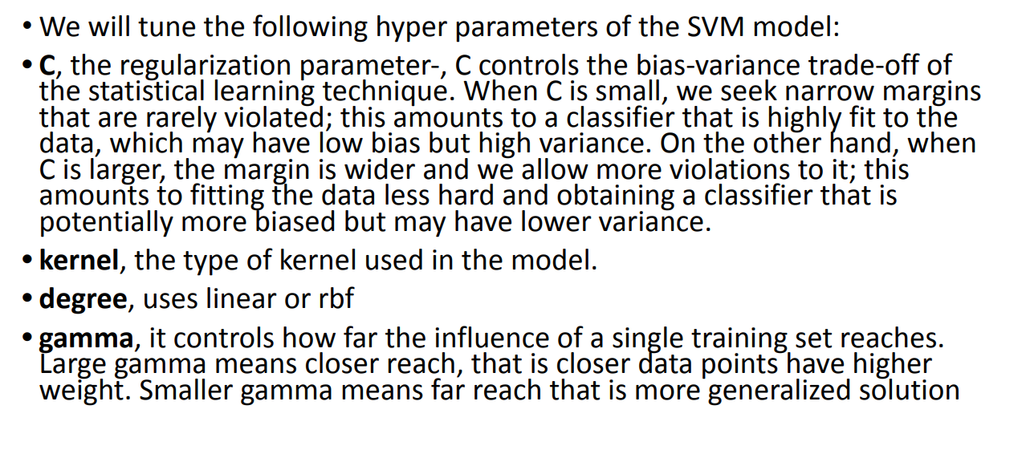
Hyper Parameters ofSVM

Slide 38
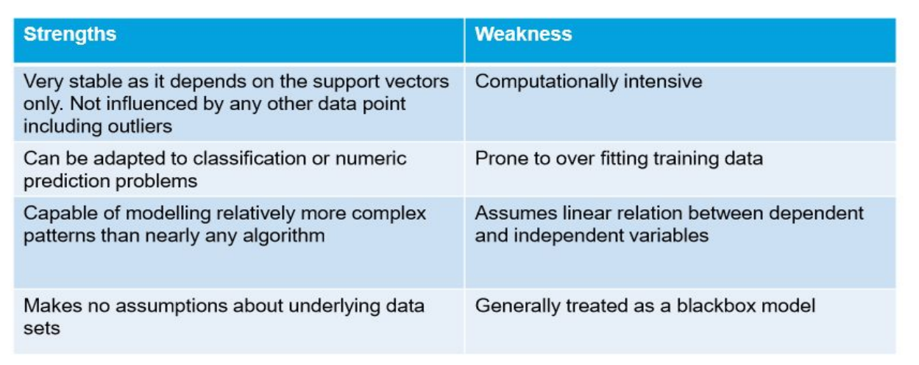
Pros and Cons of SVM

Slide 39
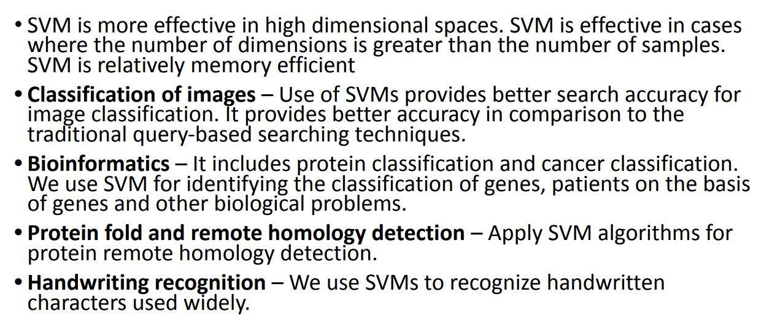
Use Cases of SVM

Slide 40
Hands on Deployment
We will create a medical diagnostic web app by working on the Pima Diabetes Dataset and create a classification model and will deploy it using streamlit
Dependencies
Jupyter Notebook
VS Code
Github account local Git Bash
Streamlit sharing account connected to Github (share.streamlit.io)

Slide 41
Reference Books
Introduction to Statistical Learning by Gareth James (Springer Publications)
Introduction to Machine Learning with Python by Andreas Muller & Sarah Guido (O’Reilly Publication)

